Slide 1
BANK MARKETING

Slide 2
Team Members
P. SRUJANA
P. ALEKHYA
P. TANUJA
S. SAI SARVANI
P. V. RAKESH

Slide 3
Bank Marketing:
“ Bank marketing is the aggregate of functions, directed at providing services to satisfy customers financial(and other related) needs and wants , more effectively and efficiently than the competitors keeping in view the organizational objectives of the bank.” …services to new customers.

Slide 4
Problem Statement:
The data is related with direct marketing campaigns (phone calls) of a banking institution. The classification goal is to predict if the client will subscribe a term deposit (variable y).

Slide 5
Data Set Information:
The data is related with direct marketing campaigns of a banking institution.
The marketing campaigns were based on phone calls. Often, more than one contact to the same client was required, in order to access if the product (bank term deposit) would be subscribed or not

Slide 6
Attributes Information :
There are several attributes given in the dataset like age , job , duration , contact , education , marital , loan, housing,………etc.
Among them we have dropped some attributes that doesn’t effect the target variable . Those are:
Contact
Month
Day_of_week
Default
Pdays

Slide 7
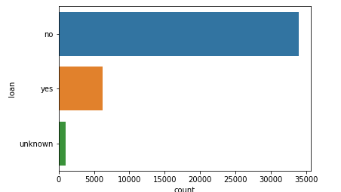
Attribute : Loan
This attribute shows that whether employee has personal loan or not? This graph shows that more number of employees don’t have any personal loan.

Slide 8
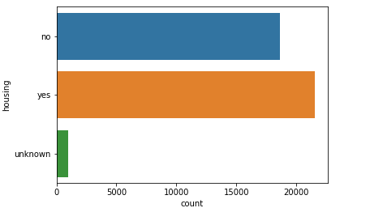
Attribute : Housing
This attribute shows that the customer has house loan or not. We can see that more number of employees have housing loan.

Slide 9
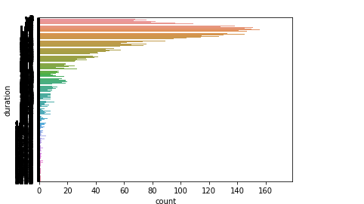
Attribute : Duration
This attribute shows that whether the client is interested in subscribing
the deposit or not based
on the phone call duration.

Slide 10
Algorithm Comparison
We have used Logistic Regression when compared with other classification techniques because the accuracy score for this algorithm is of 91% while fitting the dataset into model.

Slide 11
Logistic Regression
Logistic Regression is the appropriate regression analysis to conduct when the dependent variable is dichotomous (binary). Like all regression analyses, the logistic regression is a predictive analysis.
It is used to describe data and to explain the relationship between one dependent binary variable and one or more nominal, ordinal, interval or ratio-level independent variables

Slide 12
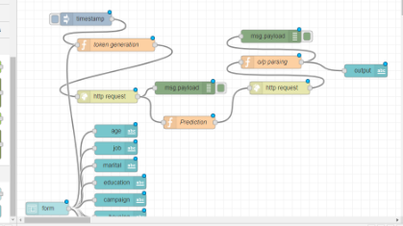
Node Red Flow

Slide 13
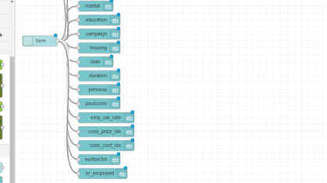

Slide 14
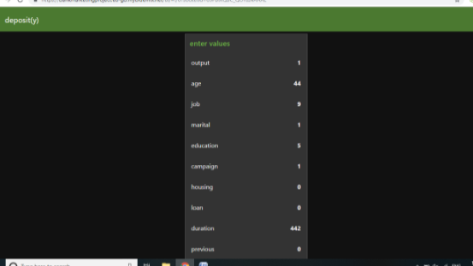
Output

Slide 15
Conclusion
Applying logistic regression algorithms, classification and estimation model were successfully built. With this model, the bank will be able to predict a customer's response to its telemarketing campaign before calling this customer.
In this way, the bank can allocate more marketing efforts to the clients who are classified as highly likely to accept term deposits, and call less to those who are unlikely to make term deposits.
Predicting the duration before calling and adjusting marketing plan benefit both the bank and its clients.

Slide 16
THANK YOU

